Slide 1

Movie app
This Photo by Unknown Author is licensed under CC BY-NC-ND
Discover and stream your favorite movies with ease using our user-friendly movie app
Live link:
https://github.com/nainajohri95/Movie-App

Slide 2

Team members
Anjali Jain (201500094)
Naina Johri ( 201500422 )
Anjali Kumari ( 201500095 )

Slide 3

Technology used:-
mongodb
Expressjs
REACT
NODE JS

Slide 4
HOME page:-
The home page of our movie app website using React features a search bar where users can search for their desired movie and get its details, including the title, release date, rating, and a thumbnail image.
The search results update dynamically as the user types, making it easy to find the movie they are looking for. Additionally, the home page includes personalized recommendations based on the user's viewing history and options to filter by genre, release year, and rating.

Slide 5
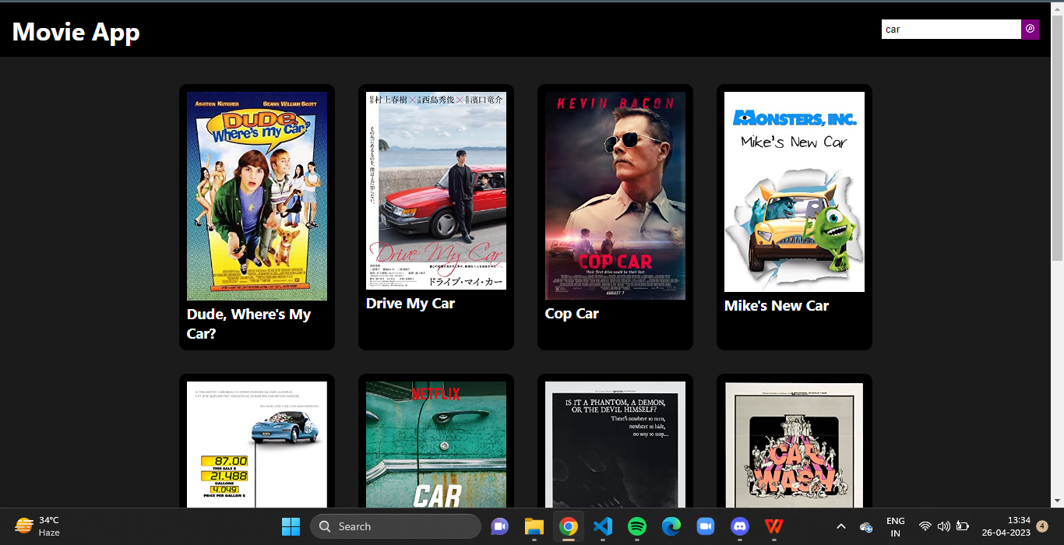

Slide 6
search bar:-
Our search bar on the home page of our movie app website using React provides various details about the movie that the user searched for, including the movie's rating, actors, and release date and year.
This feature allows users to get a comprehensive understanding of the movie and make an informed decision before streaming or watching it.
By providing detailed information, our movie app empowers users to choose the movies they want to watch with confidence.

Slide 7
Search bar

Slide 8
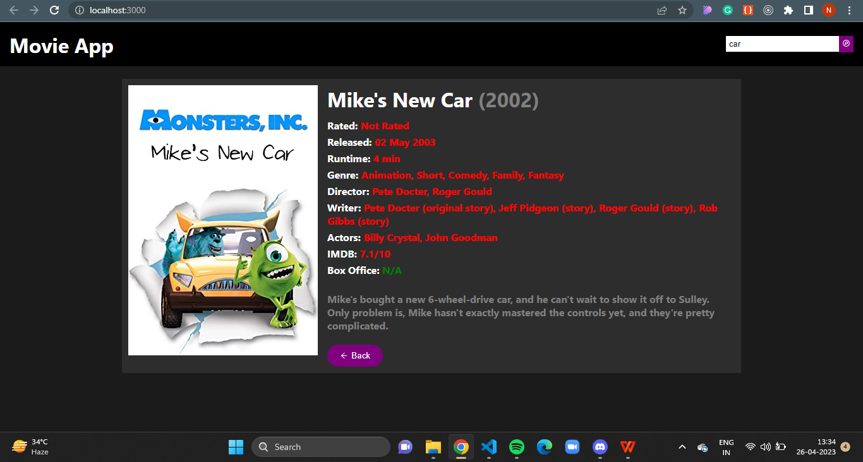
SOME GLIPMSES OF PROJECT

Slide 9
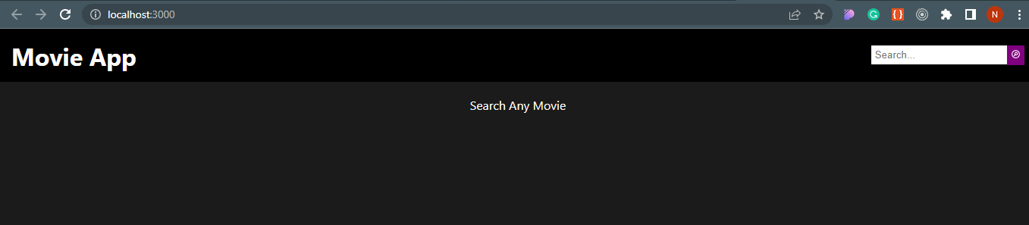

Slide 10
About us:-
Our movie app was a collaborative effort between three front-end developers –
Naina Johri
Anjali Jain
Anjali Kumari
we all three are currently in their third year of B.Tech in Computer Science at GLA University, Mathura. They have a strong foundation in web development and are well-versed in modern front-end technologies such as React, HTML, CSS, and JavaScript. With a keen eye for design and a passion for creating engaging user experiences, our team of developers worked tirelessly to create a dynamic and user-friendly movie app. Their dedication and expertise were instrumental in bringing our vision to life, and we're proud to have them on our team.

Slide 11

REFERENCES:
We are waiting for your valuable feedback.

